Slide 1
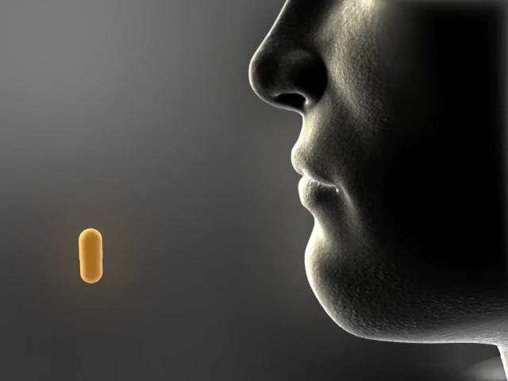
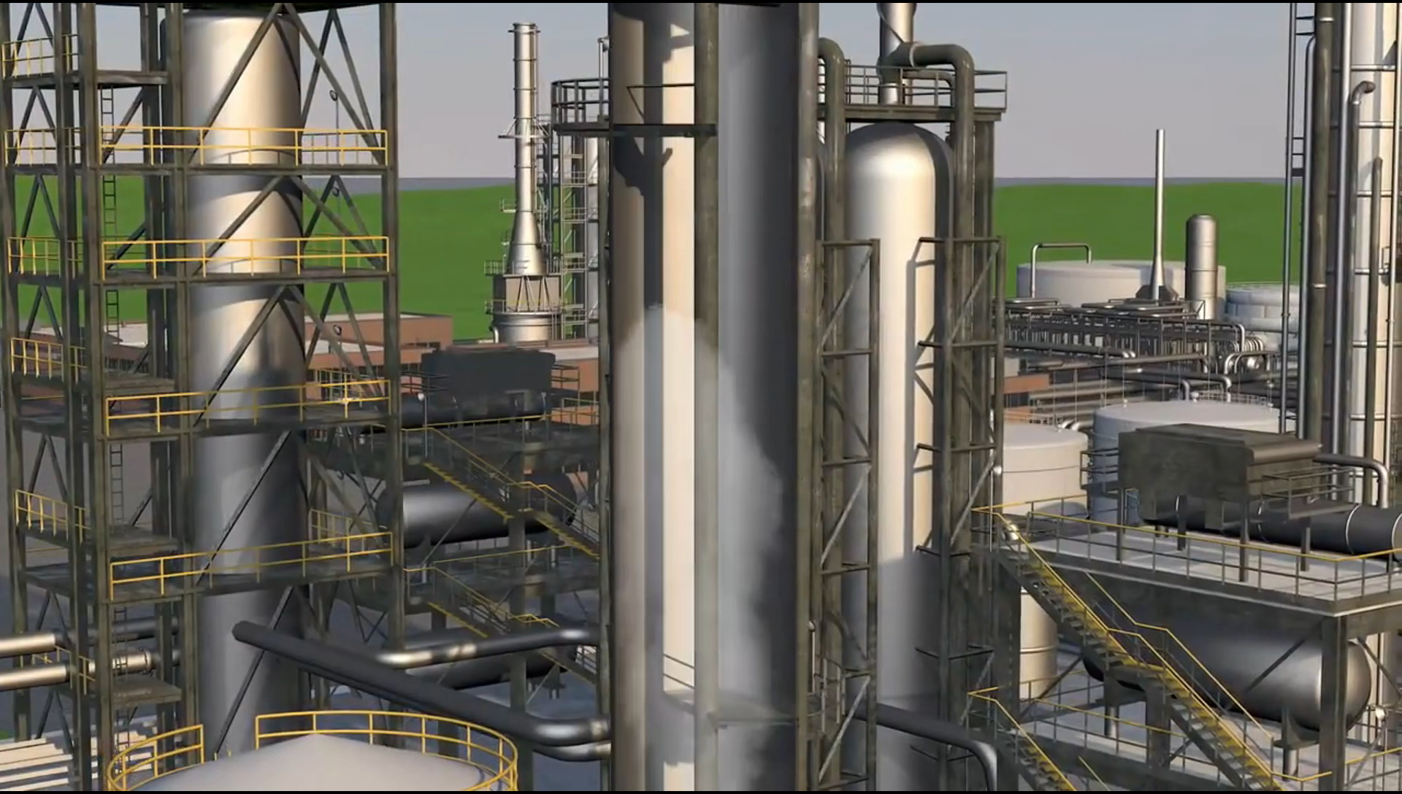

pharmacokinetics Simulation: Drug Elimination
A project done by Mai Mouhamed, Aya Ali, Salma Medhat, Salma Hossam, Mariam Alghitany, and Mariam Mahmoud
USING MATLAB
What is Pharmacokinetics?
Definition: Pharmacokinetics is the study of how drugs move through the body over time. It involves four main processes:
Absorption: How the drug enters the bloodstream.
Distribution: How the drug spreads to different organs.
Metabolism: How the body breaks down the drug.
Elimination: How the drug is removed.

Slide 2
pharmacokinetics Simulation: Drug Elimination
A project done by Mai Mouhamed, Aya Ali, Salma Medhat, Salma Hossam, Mariam Alghitany, and Mariam Mahmoud
USING MATLAB
What is Pharmacokinetics?
Definition: Pharmacokinetics is the study of how drugs move through the body over time. It involves four main processes:
Absorption: How the drug enters the bloodstream.
Distribution: How the drug spreads to different organs.
Metabolism: How the body breaks down the drug.
Elimination: How the drug is removed.

Slide 3


Why Do We Model Drug Elimination Mathematically?
Mathematical models help doctors and pharmacists answer important questions:
How long will a drug stay in the body?
When should the next dose be given?
How does kidney or liver disease affect drug clearance?
What happens if a patient takes too much or too little of a drug?
Instead of relying on trail and error, we use differential equations to predict drug behavior accurately!

Slide 4

Importance of Predicting Drug Concentration in the Body
If a drug is eliminated too quickly:
It may not work effectively (low concentration).
If a drug is eliminated too long:
It can become toxic (high concentration).
To balance safety and effectiveness, we need accurate models. Numerical methods (Euler’s, Runge-Kutta, etc.) allow us to approximate drug concentration at different times.
Notes:
- Doctors & pharmacists use these models to: Predict drug behavior in different patients. Adjust doses & timing for better treatment. Ensure drugs don’t become toxic or ineffective.

Slide 5

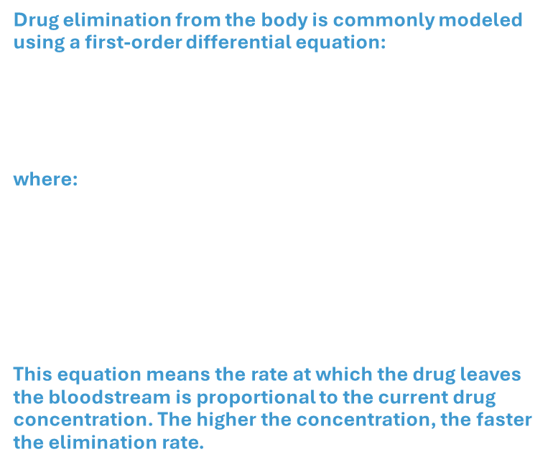
Differential Equation Used
Drug elimination from the body is commonly modeled using a first-order differential equation:
$$\frac{ⅆC}{ⅆt}=−kC$$
where:
$C$(mg/L) = Drug concentration in the bloodstream at time $t.$
$k$ (1/hr) = Elimination rate constant (depends on the drug and the patient’s metabolism).
$t$ (hours) = Time elapsed since drug administration.
This equation means the rate at which the drug leaves the bloodstream is proportional to the current drug concentration. The higher the concentration, the faster the elimination rate.

Slide 6

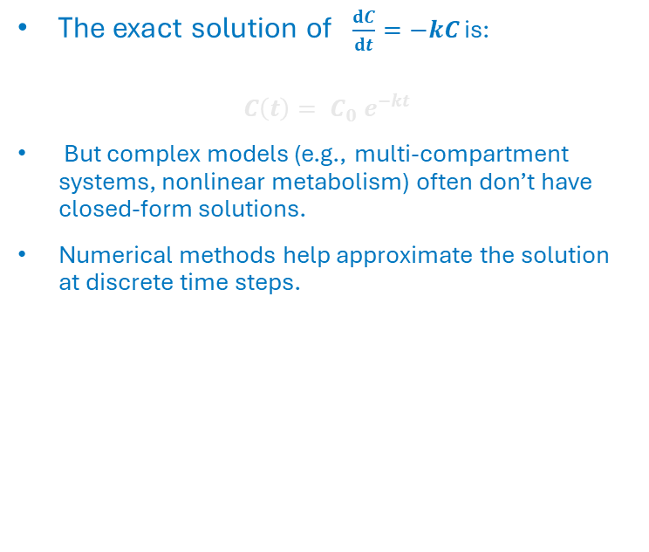
Why Not Use an Exact Formula?
The exact solution of $\frac{ⅆC}{ⅆt}=−kC$ is:
$$C\left(t\right)= C_{0} e^{−kt}$$
But complex models (e.g., multi-compartment systems, nonlinear metabolism) often don’t have closed-form solutions.
Numerical methods help approximate the solution at discrete time steps.

Slide 7
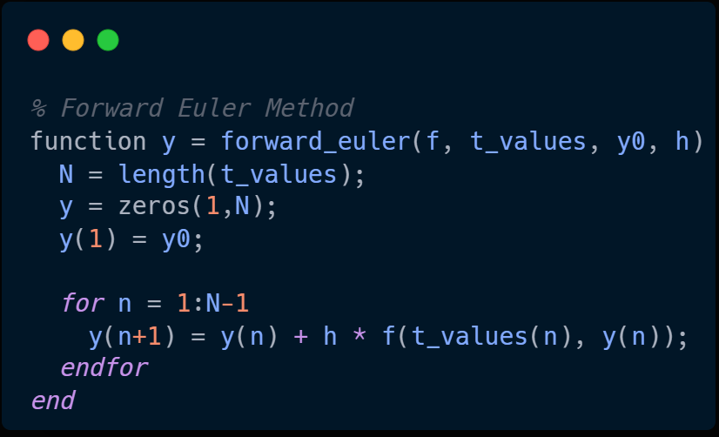

Forward Euler Method:
Pros: Easy to implement.
Cons: Low accuracy, large error for big time steps.
$$C_{n+1}=C_{n}+h\left(−kC_{n}\right)$$

Slide 8
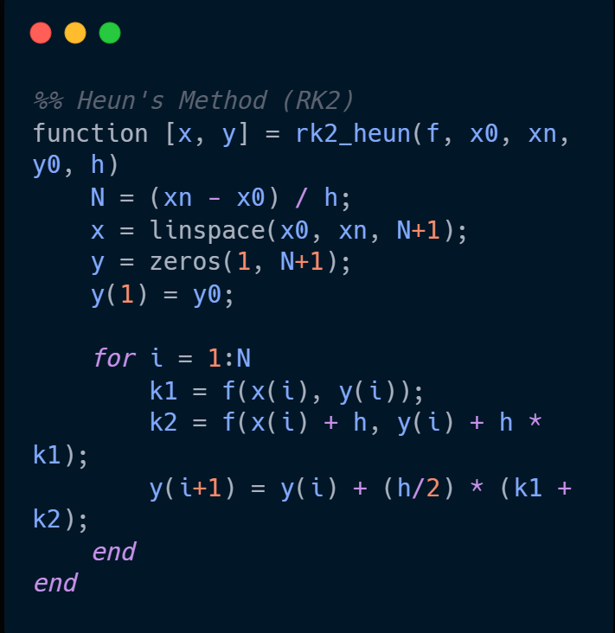


Modified Euler (Heun’s) Method:
Pros: More accurate than Forward Euler.
Cons: Slightly more computational effort.
$$C^{∗}=C_{n}+h\left(−kC_{n}\right)$$
$$C_{n+1}=C_{n}+\frac{h}{2}[\left(−kC_{n}\right)+\left(−kC^{∗}\right)]$$

Slide 9
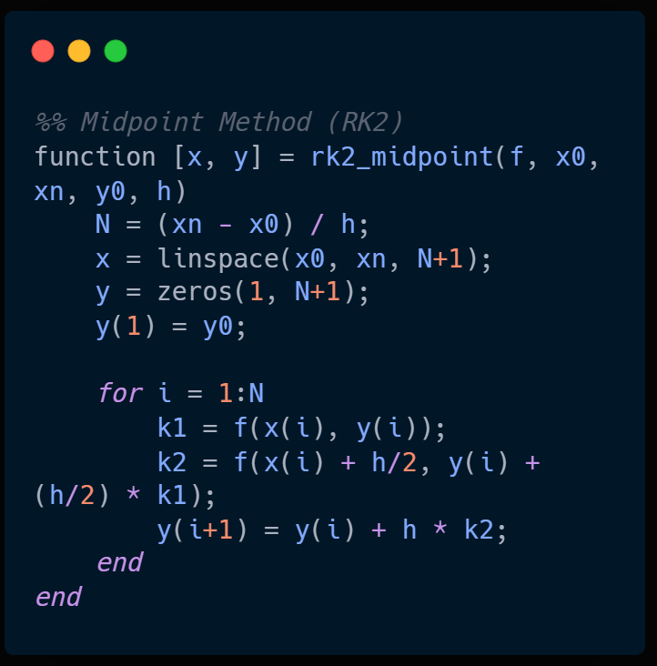

Midpoint Method:
Pros: Higher accuracy than Forward Euler.
Cons: Require an additional computation step.
$$C_{n+1}=C_{n}+h (−k. C(t_{n}+\frac{h}{2},\frac{h}{2}(−kC_{n})))$$

Slide 10
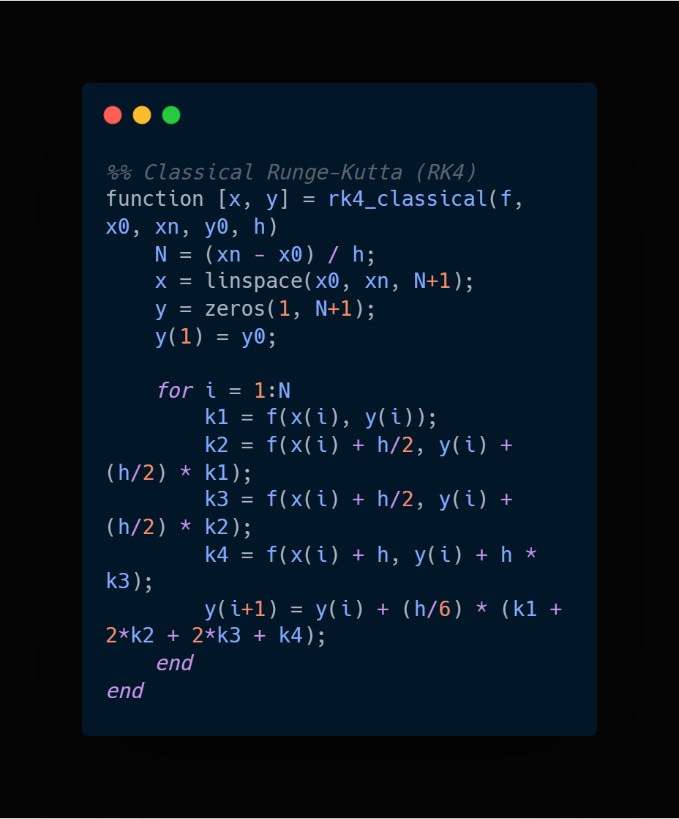



Runge-Kutta 4th Order (RK4) Method:
Pros: Very accurate and widely used in scientific computing.
Cons: More computational steps, but worth the accuracy.
$$k_{1}=h (−kC_{n})$$
$$k_{2}=h (−k(C_{n}+\frac{k_{1}}{2}))$$
$$k_{3}=h (−k(C_{n}+\frac{k_{2}}{2}))$$
$$k_{4}=h (−k(C_{n}+k_{3}))$$
$$C_{n+1}=C_{n}+\frac{1}{6}(k_{1}+2k_{2}+2k_{3}+k_{4})$$

Slide 11
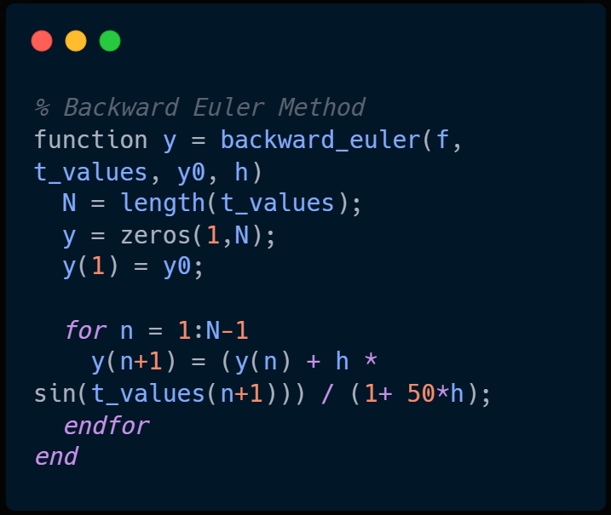

Backward Euler Method:
Pros: More stable than forward Euler, especially for stiff problems.
Cons: Require solving an equation at each step.
$$C_{n+1}=C_{n}+h\left(−kC_{n+1}\right)$$

Slide 12
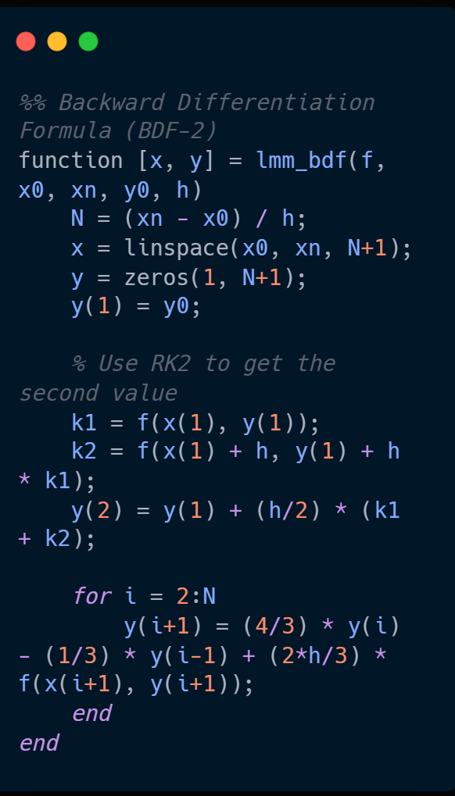

Backward Differentiation Formula (BDF):
Pros: More stable than single-step methods.
Cons: Requires multiple past values to start.
$$\frac{3C_{n+1}−4C_{n}+C_{n−1}}{2h}=−kC_{n+1}$$

Slide 13
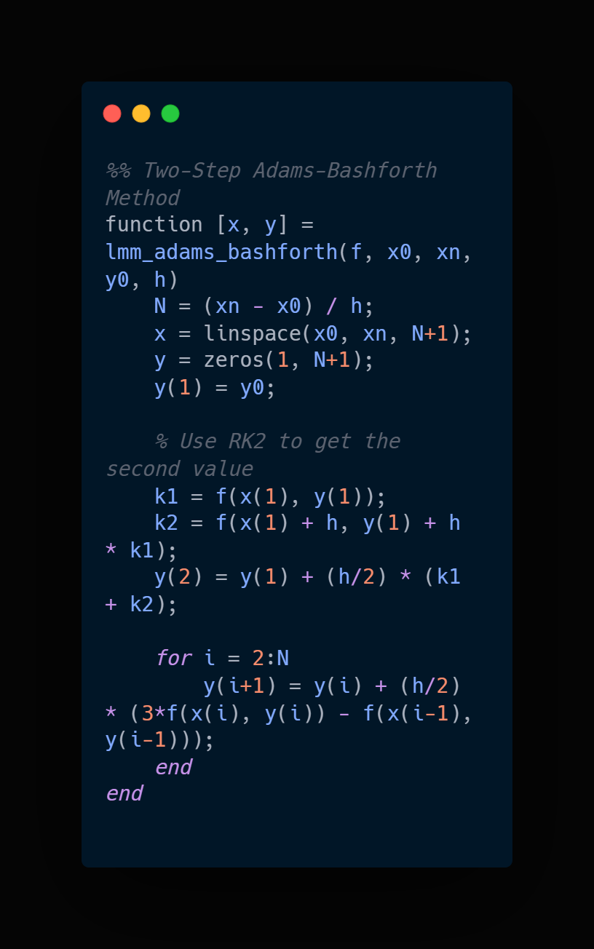
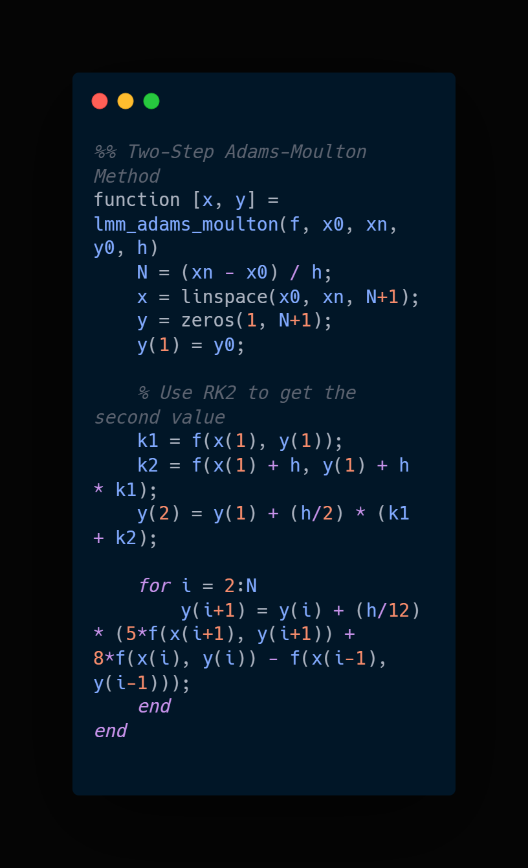
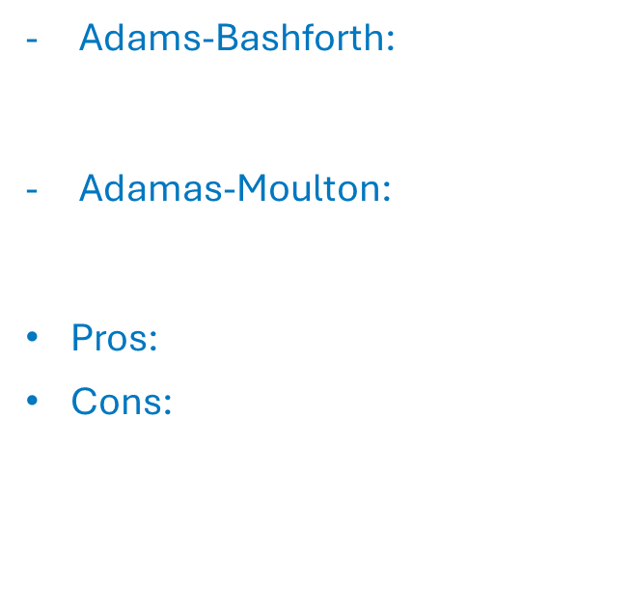
Linear Multistep Methods:
Adams-Bashforth: Uses previous values to predict $C_{n+1}$.
Adamas-Moulton: Uses implicit correction for better accuracy.
Pros: Easy to implement.
Cons: Low accuracy, large error for big time steps.

Slide 14

Ibuprofen Eliminations Using Numerical Methods
A patient takes a 400 mg dose of ibuprofen for pain relief. The drug follows a first-order elimination process in the body, with an elimination rate constants of k = 0.564/hour. The initial concentration in plasma is 34 mg/L at t = 1 hour after ingestion.
Using numerical methods such as Backward Euler of the BDF metho, solve the following:
1- Plasma Concentration Over Time
Use the first-order elimination equation to estimate the ibuprofen concentration at 2, 4, 6, 9, and 12 hours.
Compare your results with the given experimental data:
Time (h) | Concentration (mg/L)
2 | 30.4
4 | 13.5
6 | 6.3
9 | 2.2
12 | 0.6

Slide 15
Ibuprofen Eliminations Using Numerical Methods
2- Urine Excretion
The total volume of urine collected at different time intervals is recorded as follows:
Use numerical methods to estimate the drug concentration in urine at t = 3, 5, 6, 7, and 11 hours.
Time (h) | Urine Concentration (mg/L) | Urine Volume (mL)
2 | 25.4 | 290
4 | 134.0 | 70
6 | 29.1 | 120
8 | 20.7 | 140
10 | 4.9 | 170
12 | 8.2 | 200
24 | 0.4 | 240

